Slide 1
Spatial Filtering

Slide 2
Background
Filter term in “Digital image processing” is referred to the subimage
There are others term to call subimage such as mask, kernel, template, or window
The value in a filter subimage are referred as coefficients, rather than pixels.

Slide 3
Basics of Spatial Filtering
The concept of filtering has its roots in the use of the Fourier transform for signal processing in the so-called frequency domain.
Spatial filtering term is the filtering operations that are performed directly on the pixels of an image

Slide 4
Mechanics of spatial filtering
The process consists simply of moving the filter mask from point to point in an image.
At each point (x,y) the response of the filter at that point is calculated using a predefined relationship

Slide 5

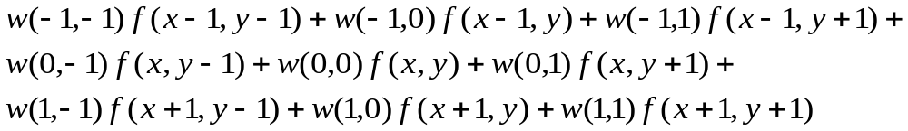
Linear spatial filtering
Pixels of image
The result is the sum of products of the mask coefficients with the corresponding pixels directly under the mask
f(x-1,y-1)
w(-1,-1)
f(x-1,y)
w(-1,0)
f(x-1,y+1)
w(-1,1)
f(x,y-1)
w(0,-1)
f(x,y)
w(0,0)
f(x,y+1)
w(0,1)
f(x+1,y-1)
Mask coefficients
w(1,-1)
f(x+1,y)
w(1,0)
f(x+1,y+1)
w(1,1)
w(-1,-1)
w(-1,0)
w(-1,1)
w(0,-1)
w(0,0)
w(0,1)
w(1,-1)
w(1,0)
w(1,1)

Slide 6
Note: Linear filtering
The coefficient w(0,0) coincides with image value f(x,y), indicating that the mask is centered at (x,y) when the computation of sum of products takes place.
For a mask of size mxn, we assume that m=2a+1 and n=2b+1, where a and b are nonnegative integer. Then m and n are odd.

Slide 7
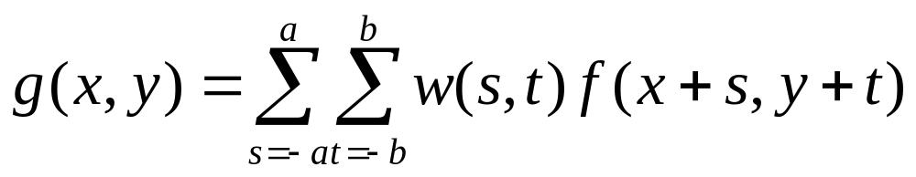
Linear filtering
In general, linear filtering of an image f of size MxN with a filter mask of size mxn is given by the expression:

Slide 8
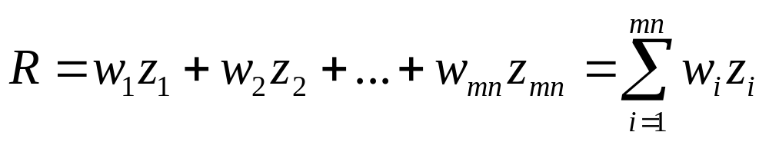
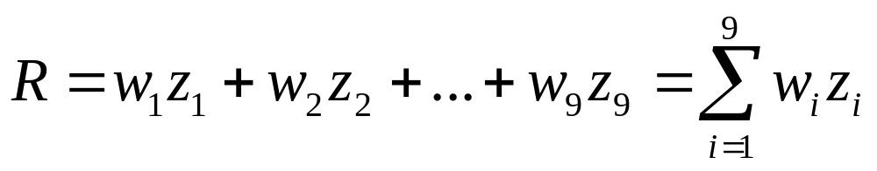
Discussion
The process of linear filtering similar to a frequency domain concept called “convolution”
Simplify expression
w₁
w₂
w₃
w₄
w₅
w₆
w₇
w₈
w₉
Where the w’s are mask coefficients, the z’s are the value of the image gray levels corresponding to those coefficients

Slide 9
Nonlinear spatial filtering
Nonlinear spatial filters also operate on neighborhoods, and the mechanics of sliding a mask past an image are the same as was just outlined.
The filtering operation is based conditionally on the values of the pixels in the neighborhood under consideration.
Find the max value.

Slide 10
Smoothing Spatial Filters
Smoothing filters are used for blurring and for noise reduction.
  Blurring is used in preprocessing steps, such as removal of small details from an image prior to object extraction, and bridging of small gaps in lines or curves
  Noise reduction can be accomplished by blurring

Slide 11

Type of smoothing filtering
There are 2 way of smoothing spatial filters
  Smoothing Linear Filters
  Order-Statistics Filters

Slide 12
Smoothing Linear Filters
Linear spatial filter is simply the average of the pixels contained in the neighborhood of the filter mask.
Sometimes called “averaging filters”.
The idea is replacing the value of every pixel in an image by the average of the gray levels in the neighborhood defined by the filter mask.

Slide 13
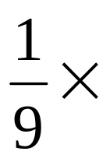
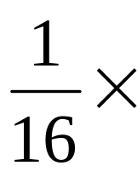
Two 3x3 Smoothing Linear Filters
1
1
1
1
2
1
1
1
1
2
4
2
1
1
1
1
2
1
Standard average
Weighted average

Slide 14
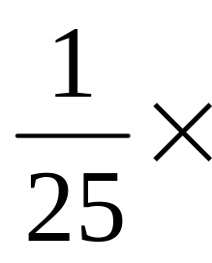
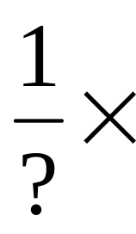
5x5 Smoothing Linear Filters
1
1
1
1
1
1
1
1
1
1
1
1
1
1
1
1
1
1
1
1
1
1
1
1
1

Slide 15
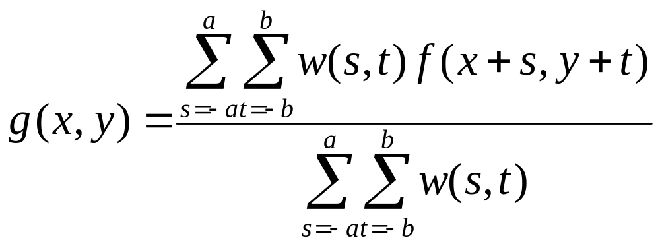
Smoothing Linear Filters
The general implementation for filtering an MxN image with a weighted averaging filter of size mxn is given by the expression

Slide 16
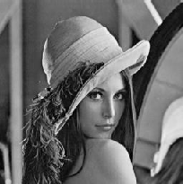
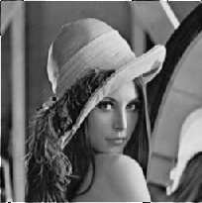
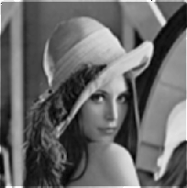

Result of Smoothing Linear Filters
Original Image
[3x3]
[5x5]
[7x7]

Slide 17
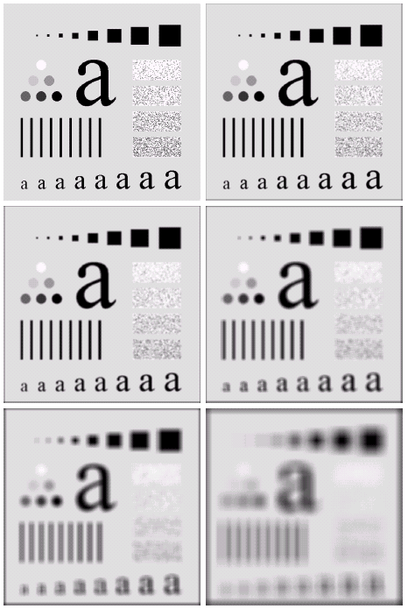
Spatial filtering for Smoothing (example)
Original image size: 500 x 500
Smoothed by 3 x 3 box filter
Smoothed by 5 x 5 box filter
Smoothed by 9 x 9 box filter
Smoothed by 15 x 15 box filter
Smoothed by 35 x 35 box filter
Digital Image Processing

Slide 18
Order-Statistics Filters
Order-statistics filters are nonlinear spatial filters whose response is based on ordering (ranking) the pixels contained in the image area encompassed by the filter, and then replacing the value of the center pixel with the value determined by the ranking result.
Best-known “median filter”

Slide 19
Process of Median filter
Corp region of neighborhood
Sort the values of the pixel in our region
In the MxN mask the median is MxN div 2 +1
10
15
20
20
100
20
20
20
25
10, 15, 20, 20, 20, 20, 20, 25, 100
5th

Slide 20
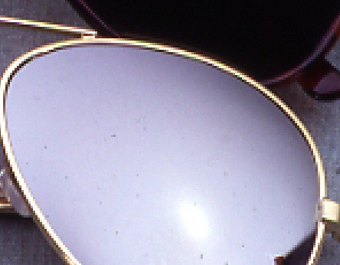
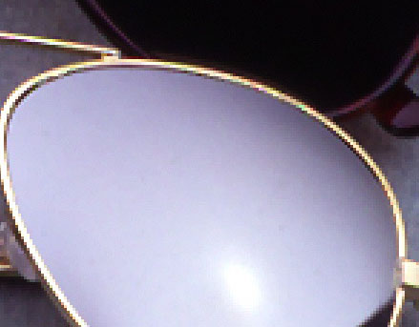
Result of median filter
Noise from Glass effect
Remove noise by median filter

Slide 21

Median Filtering (example)
Digital Image Processing

Slide 22
Sharpening Spatial Filters
The principal objective of sharpening is to highlight fine detail in an image or to enhance detail that has been blurred, either in error or as an natural effect of a particular method of image acquisition.

Slide 23
Introduction
The image blurring is accomplished in the spatial domain by pixel averaging in a neighborhood.
Since averaging is analogous to integration.
Sharpening could be accomplished by spatial differentiation.

Slide 24
Foundation
We are interested in the behavior of these derivatives in areas of constant gray level(flat segments), at the onset and end of discontinuities(step and ramp discontinuities), and along gray-level ramps.
These types of discontinuities can be noise points, lines, and edges.

Slide 25
Definition for a first derivative
Must be zero in flat segments
Must be nonzero at the onset of a gray-level step or ramp; and
Must be nonzero along ramps.

Slide 26
Definition for a second derivative
Must be zero in flat areas;
Must be nonzero at the onset and end of a gray-level step or ramp;
Must be zero along ramps of constant slope

Slide 27
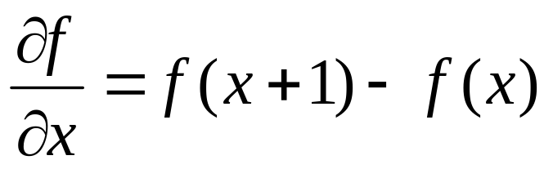
Definition of the 1st-order derivative
A basic definition of the first-order derivative of a one-dimensional function f(x) is

Slide 28
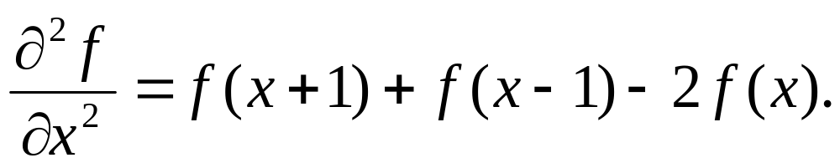
Definition of the 2nd-order derivative
We define a second-order derivative as the difference

Slide 29

Gray-level profile
0
0
0
1
2
3
2
0
0
2
2
6
3
3
2
2
3
3
0
0
0
0
0
0
7
7
6
5
5
3
7
6
5
4
3
2
1
0

Slide 30
Derivative of image profile
0 0 0 1 2 3 2 0 0 2 2 6 3 3 2 2 3 3 0 0 0 0 0 0 7 7 6 5 5 3
first
0 0 1 1 1-1-2 0 2 0 4-3 0-1 0 1 0-3 0 0 0 0 0-7 0-1-1 0-2
second
0-1 0 0-2-1 2 2-2 4-7 3-1 1 1-1-3 3 0 0 0 0-7 7-1 0 1-2

Slide 31
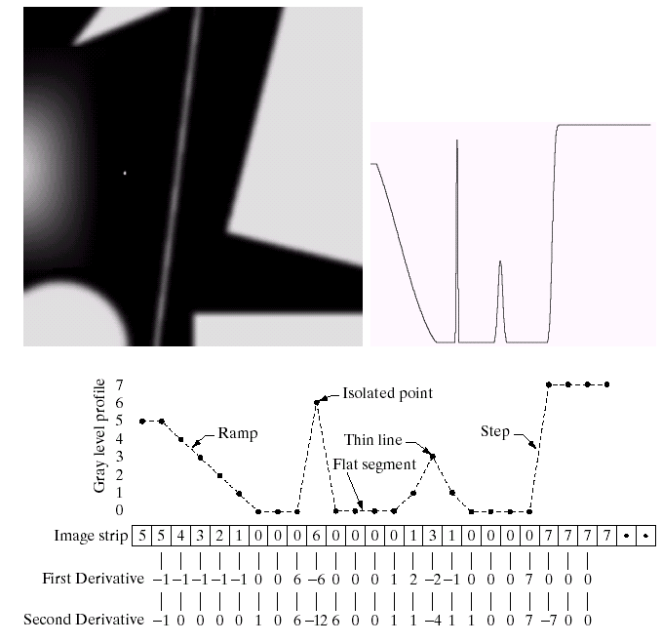
Example for discrete derivatives
Digital Image Processing

Slide 32
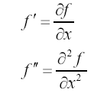
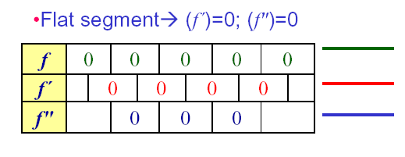
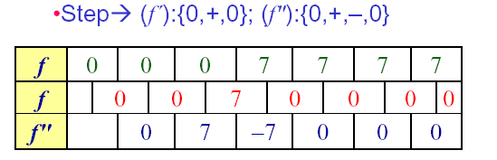
Various situations encountered for derivatives
Digital Image Processing

Slide 33
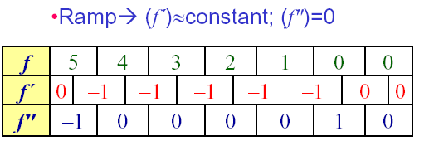
Various situations encountered for derivatives
Ramps or steps in the 1D profile normally characterize the edges in an image
f ″ is nonzero at the onset and end of the ramp:
produce thin (double) edges
f ′ is nonzero along the entire ramp produce thick edges
Digital Image Processing

Slide 34
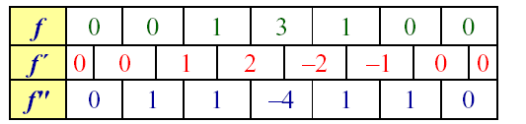
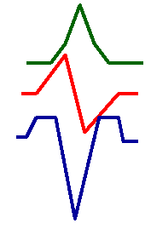
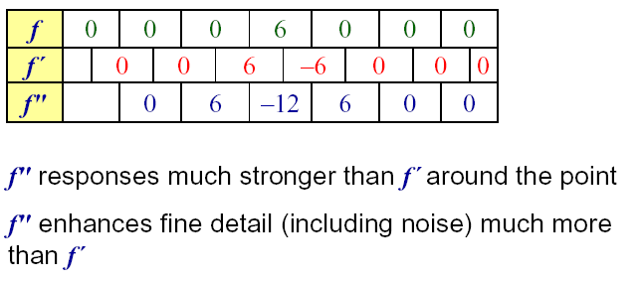
Various situations encountered for derivatives
Thin lines
Isolated point
Digital Image Processing

Slide 35
Comparison between f" and f´
f´’ generally produce thicker edges in an image
f" have a stronger response to file detail
f ‘ generally have a stronger response to a gray-level step
f" produces a double response at step changes in gray level
f" responses given similar changes in gray-level values line > point > step
For image enhancement, f" is generally better suited than f´’
Major application of f´’is for edge extraction; f´’ used together with f" results in impressive enhancement effect
Digital Image Processing

Slide 36
Analyze
The 1st-order derivative is nonzero along the entire ramp, while the 2nd-order derivative is nonzero only at the onset and end of the ramp.
The response at and around the point is much stronger for the 2nd- than for the 1st-order derivative
1st make thick edge and 2nd make thin edge

Slide 37
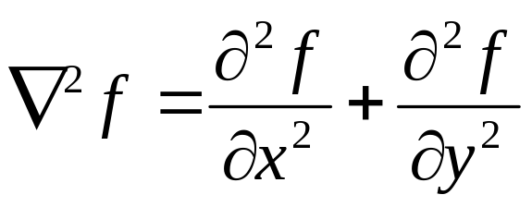
The Laplacian (2nd order derivative)
Shown by Rosenfeld and Kak[1982] that the simplest isotropic derivative operator is the Laplacian is defined as

Slide 38
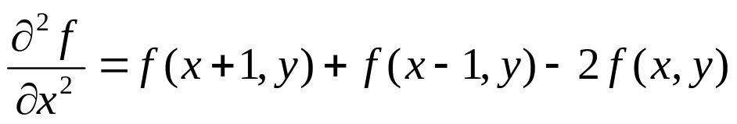
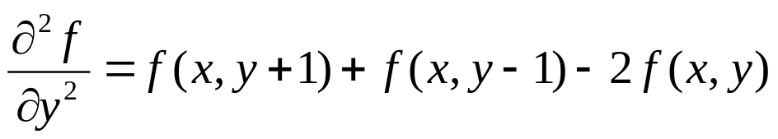
Discrete form of derivative
f(x-1,y)
f(x,y)
f(x+1,y)
f(x,y-1)
f(x,y)
f(x,y+1)

Slide 39
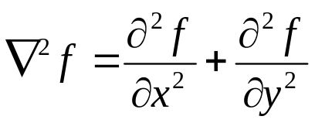
2-Dimentional Laplacian
The digital implementation of the 2-Dimensional Laplacian is obtained by summing 2 components
1
1
-4
1
1

Slide 40
Laplacian
0
1
0
1
1
1
1
-4
1
1
-8
1
0
1
0
1
1
1
1
0
1
0
-4
0
1
0
1

Slide 41
Laplacian
0
-1
0
-1
-1
-1
-1
4
-1
-1
8
-1
0
-1
0
-1
-1
-1
-1
0
-1
0
4
0
-1
0
-1

Slide 42
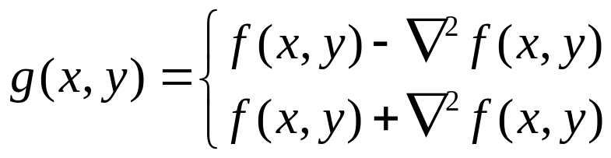

Implementation
If the center coefficient is negative
If the center coefficient is positive
Where f(x,y) is the original image
is Laplacian filtered image
g(x,y) is the sharpen image

Slide 43
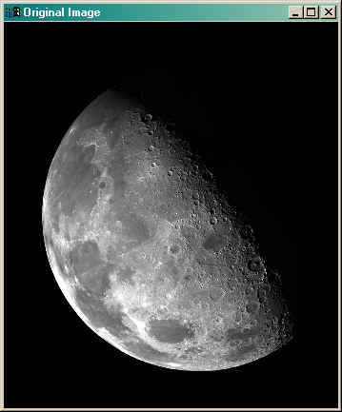

Slide 44
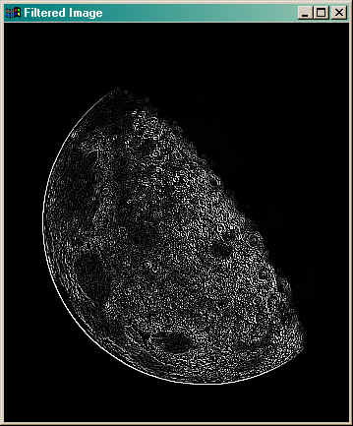

Slide 45
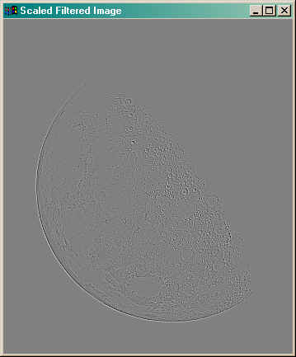

Slide 46
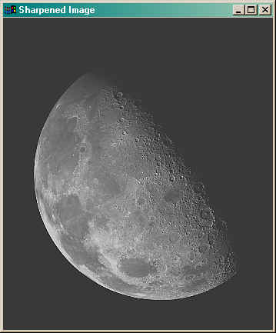

Slide 48
Algorithm
Using Laplacian filter to original image
And then add the image result from step 1 and the original image

Slide 49
Simplification
We will apply two step to be one mask
0
-1
0
-1
-1
-1
-1
5
-1
-1
9
-1
0
-1
0
-1
-1
-1

Slide 50




Unsharp masking
A process to sharpen images consists of subtracting a blurred version of an image from the image itself. This process, called unsharp masking, is expressed as
Where denotes the sharpened image obtained by unsharp masking, and is a blurred version of

Slide 51

High-boost filtering
A high-boost filtered image, f_{hb} is defined at any point (x,y) as
This equation is applicable general and does not state explicity how the sharp image is obtained

Slide 52
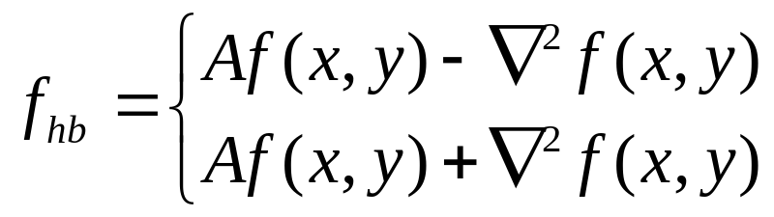
High-boost filtering and Laplacian
If we choose to use the Laplacian, then we know f_{s}(x,y)
If the center coefficient is negative
If the center coefficient is positive
0
-1
0
-1
-1
-1
-1
A+4
-1
-1
A+8
-1
0
-1
0
-1
-1
-1

Slide 53
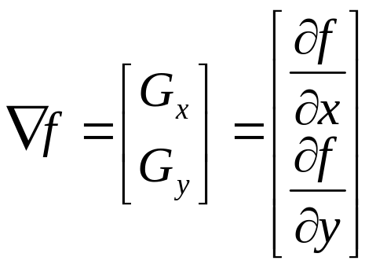
The Gradient (1st order derivative)
First Derivatives in image processing are implemented using the magnitude of the gradient.
The gradient of function f(x,y) is

Slide 54
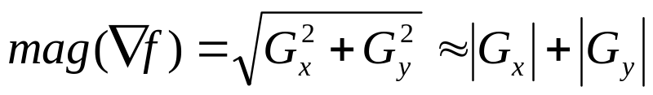
Gradient
The magnitude of this vector is given by
G_{x}
-1
1
This mask is simple, and no isotropic. Its result only horizontal and vertical.
G_{y}
1
-1

Slide 55
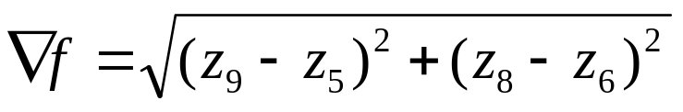
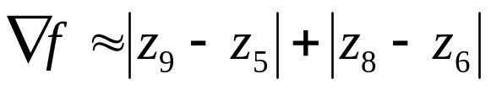
Robert’s Method
The simplest approximations to a first-order derivative that satisfy the conditions stated in that section are
z₁
z₂
z₃
G_{x} = (z₉-z₅) and G_{y} = (z₈-z₆)
z₄
z₅
z₆
z₇
z₈
z₉

Slide 56
Robert’s Method
These mask are referred to as the Roberts cross-gradient operators.
-1
0
0
-1
0
1
1
0

Slide 57
Sobel’s Method
Mask of even size are awkward to apply.
The smallest filter mask should be 3x3.
The difference between the third and first rows of the 3x3 mage region approximate derivative in x-direction, and the difference between the third and first column approximate derivative in y-direction.

Slide 58
Sobel’s Method
Using this equation
-1
-2
-1
-1
0
1
0
0
0
-2
0
2
1
2
1
-1
0
1

Slide 59
Homework
ลองนำภาพสีมาหา sharpening โดยใช้ filter
  Laplacian
  High-boost with laplacian
  Gradient
  Robert
  Sobel
  my mask
-1
-2
-1
-1
-2
-1
-2
12
-2
-2
-12
-2
-1
-2
-1
-1
-2
-1

